Slide 1
Models of TeV scale gravity at the LHC
Savina Maria, JINR
March 5, 2014
EU-Russia-JINR@Dubna Round Table

Slide 2

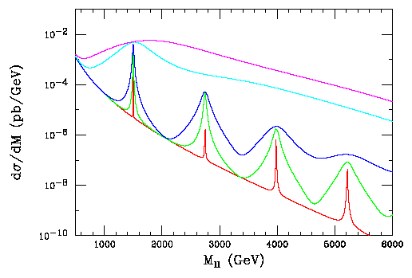
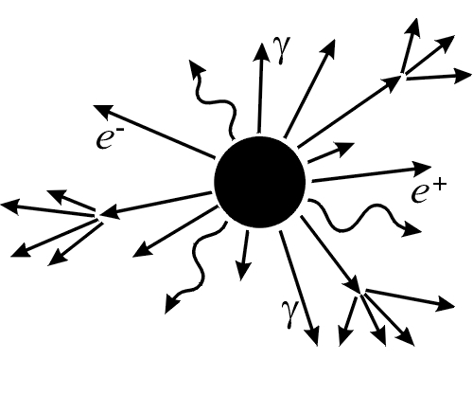
TeV scale gravity signals
Two types of signals
KK-modes of graviton Microscopic black holes
Heavy graviton resonances (RS1 model), one warped extra dimension n_{ED}=1
Non-resonant models like ADD and contact interactions, number of ED n_{ED} = 2 ÷ 7, scale M_{S(D)}
Experimental observables:
Dilepton (dijet, diphoton) spectra, Jet + missing E_{T}, effective description like CI (non-resonant signs).
Very specific signature:
Production without suppression from small coupling constant, Hawking evaporation, corrected black body decay spectrum, large multiplicity in FS, ellipsoid shape.
Huge number of variables in analyses.
Experimental observables:
Scalar sum of the transverse energies of jets (S_{T}), an asymmetry in dijet production (like CI)
curvature k (~M_{D}), compactification radius r,
coupling constant: c = k/M_{Pl},
gravity scale : M_{D}
Number of ED
n_{ED} = 2 ÷ 7
Entangled M_{D}, M^{min}_{BH}
Observation of BH-type
signals doesn’t allow
to get a fundamental
multidimensional scale
directly from an experiment!

Slide 3
ADD: flat large extra dimensions
N.Arkani-Hamed, S.Dimopoulos, G.Dvali ’98
Multidimensional gravity action with multidimensional constant G_{(D)}
effective
4D-action
Planck mass becomes effective derived from the “true” multidimensional mass scale:
where
A size of extra dimensions depends on a number of ED and a multidimensional scale
(for М about a few ТэВ )
The hierarchy problem solution!

Slide 4
Size of ED in ADD

Slide 5
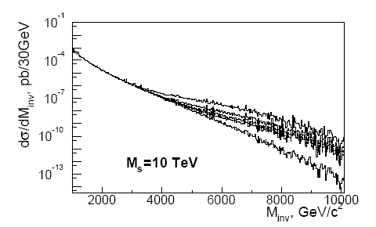
DY process in ADD
LO xsec
HLZ – (M_{S}(ŝ) ,n) GRW – Λ_{T} (n>2)
Tao Han, Joseph D. Lykken, Gian F. Giudice, Riccardo Rattazzi,
Ren-Jie Zhang James D. Wells

Slide 6
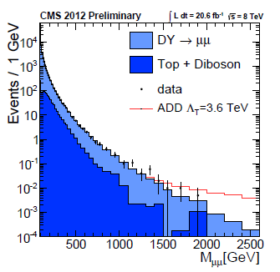
Exclusion limits for ADD, 8 TeV, 2012
ADD model
Virtual G exchange
“Direct” measurement Λ_{T} through M_{max}
CMS PAS EXO-12-027
Dimuons, 20.6 fb⁻¹
CMS PAS EXO-12-031
Dielectrons, 19,6 fb⁻¹
M_{s} is excluded
up to 4940 GeV
at 95% C.L.
depending on n_{ED}
6

Slide 7
Exclusion limits for ADD, 8 TeV, 2012
CMS PAS EXO-12-048

Slide 8
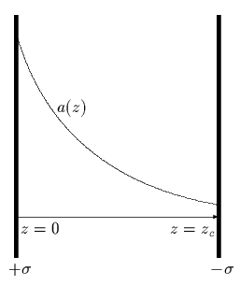


Gravity in a curved bulk space: RS1
A 5D action is a subject for fine-tuning:
4D asymptotically flat metric
can be obtained only putting
The hierarchy is solved to be exponential!
F.R.: H. Davoudiasl, J.L. Hewett, and T.G. Rizzo, hep-ph/0006041

Slide 9
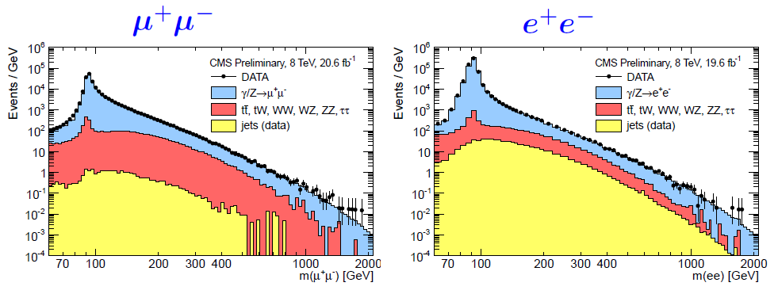
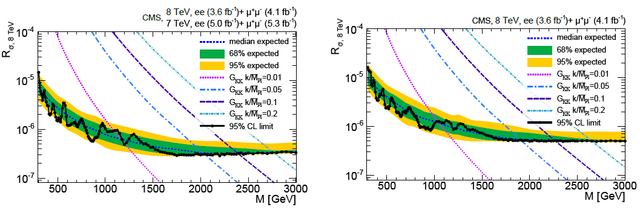
RS1 graviton in dilepton spectra
CMS EXO-12-061
Full statistics on
resonances in dileptons,
2012
the latest result
A paper for RS1 graviton:
Phys. Lett. B720 (2013) 63
C=0.10 is excluded below 2390 GeV
C=0.05 is excluded below 2030 GeV

Slide 10
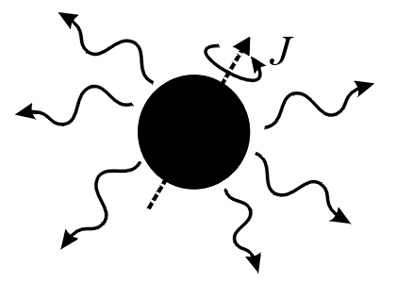
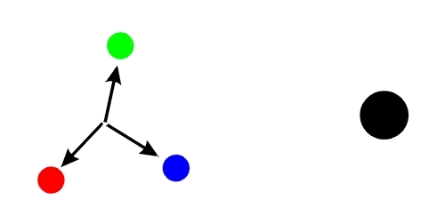
Evolution Stages for BH
I. Balding phase
Asymmetric production, but “No hair” theorem: BH sheds
its high multipole moments for fields (graviton and GB
emitting classically), as electric charge and color.
Characteristic time is about t ~ R_{S}
Result: BH are classically stable objects
II-III. Hawking radiation phases (short spin down +
more longer Schwarzschild)
Quantum-mechanical decay trough tunneling, transition
from Kerr spinning BH to stationary Schwarzschild one.
angular momentum shedding.
After this – thermal decay to all SM particles with black
body energy spectra. Accelerating decay with a varying
growing temperature. No flavor dependence, only number
of D.o.f.– “democratic” decay
Correction with Gray Body Factors
IV. Planck phase: final explosion (subj for QGr)
BH remnant (non-detectable energy losses), N-body
decay, Q, B, color are conserved or not conserved

Slide 11
SBH solutions: 4D vs (4+n)D
4D flat
(4+n)D flat
Schwarzschild raduis of a
multidimensional BH
(R.C. Myers and M.J. Perry, Ann. Phys.
172, 304, 1986)

Slide 12
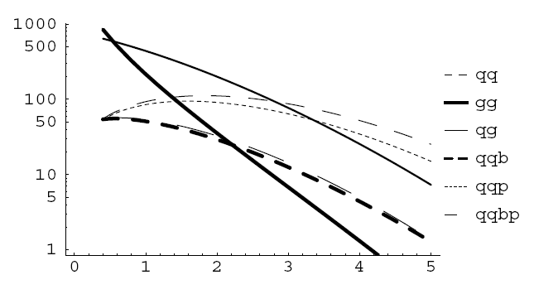
BH Production in pp collisions: well-known formulas
BH production cross section
(S. Dimopoulos, G. Landsberg,
Phys.Rev.Lett.87:161602, 2001
hep-ph/0106295v1)
PDF’s

Slide 13
BH Production in pp collisions at the LHC
Increasing cross section, no suppression
from small couplings
Production of KK modes in
TeV scale gravity:
ADD, M_{d}=3 TeV,
RS, c = k/M_{Pl} = 0.01-0.1
M_{d}=1.5 TeV,

Slide 14
TSM and an inelasticity in BH production
;
;
What part of initial collision energy actually was trapped in BH formation process?
inelasticity (pp → BH + X) – function of n,b
H. Yoshino and Y. Nambu, Phys. Rev. D 67, 024009(2003), gr-qc/0209003;
H. Yoshino and V. S. Rychkov, Phys. Rev. D 71, 104028 (2005), arXiv:hep-th/0503171
L. A. Anchordoqui, J.L. Feng, H. Goldberg, and A.D. Shapere, hep-ph/0311365

Slide 15
TSM: xsec enhancement
H. Yoshino and V. S. Rychkov, Phys. Rev. D 71, 104028 (2005), arXiv:hep-th/0503171

Slide 16
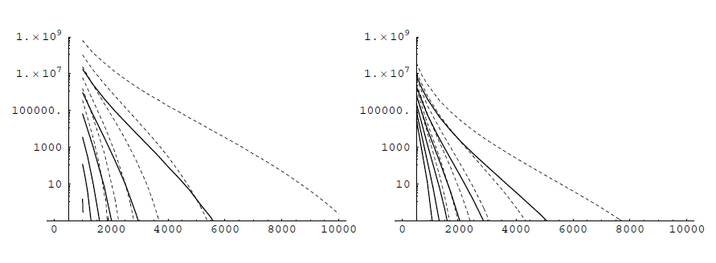
TSM: inelasticity and “production efficiency curves”
Apparent horizon, M_{AH}
H. Yoshino and Y. Nambu, Phys. Rev. D 67, 024009
(2003), gr-qc/0209003
n=6, ADD
n=1, RS
Total BH prod.
xsecs, fb
with (solid) and
without (dashed)
an inelasticity
P. Meade and L. Randall, JHEP 05, 003 (2008), arXiv:0708.3017

Slide 17
Hawking Evaporation of BH
Hawking temperature
(R.C. Myers and M.J. Perry,
Ann. Phys. 172, 304, 1986)

Slide 18
4D vs (4+n)D: relations for T_{H}, r_{S}, τ
(4+n)D BH is larger, colder and has a larger lifetime in comparison to
4D BH with the same mass М
BH radiates predominantly on the brane

Slide 19
Entropy, BH decay and M_{min}(BH)
BH Entropy
S_{BH} must be large enough to
reproduce thermal BH decay
(S.B. Giddings, hep-ph/0110127v3,
K. Cheung, Phys. Rev. Lett. 88, 221602,
2002)
Democratic decay blinded to flavor:
probabilities are the same for all species
(violation of some conservation laws)

Slide 20
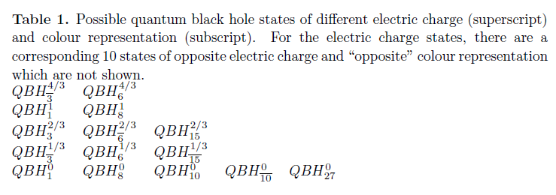
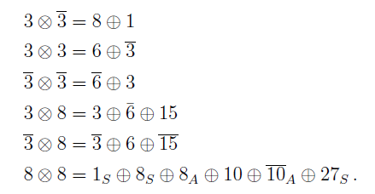
Quantum Black Holes
Production near the threshold, small entropy, M_{min} ~ M_{D}
Patrick Meade and Lisa Randall, arXiv:0708.3017
Douglas M. Gingrich, arXiv:0912.0826
significant back-reaction,
strongly coupled resonances or gravity bound state

Slide 21
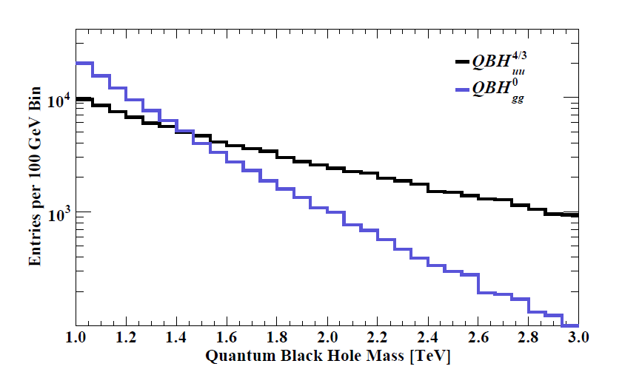
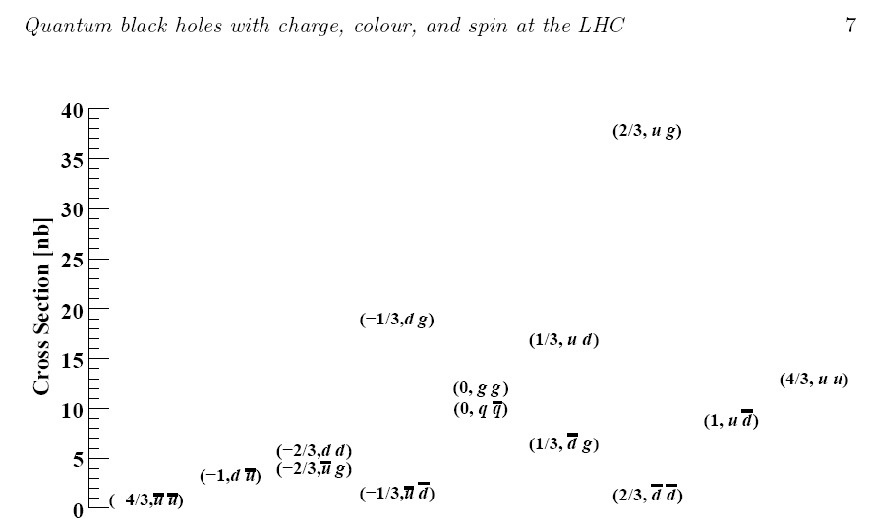
Quantum Black Holes
Douglas M. Gingrich, arXiv:0912.0826

Slide 22
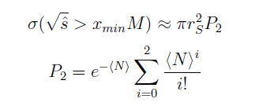
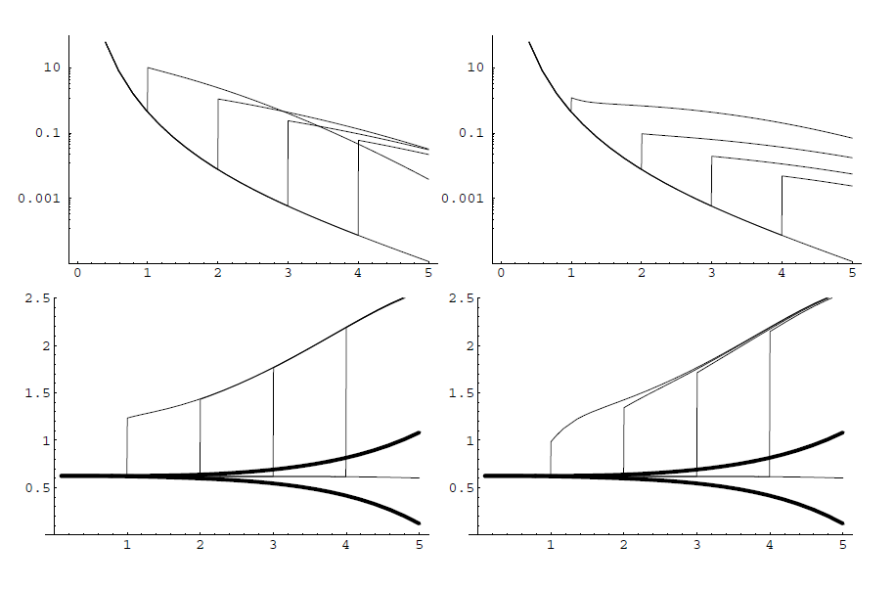
Quantum BH – two body final states
n=6, ADD
M=1,2,3,4
n=1, RS
M=1,2,3,4
QBH production xsec
FS asymmetry
x_min=1
x_min=1
P. Meade and L. Randall, JHEP 05, 003 (2008), arXiv:0708.3017

Slide 23
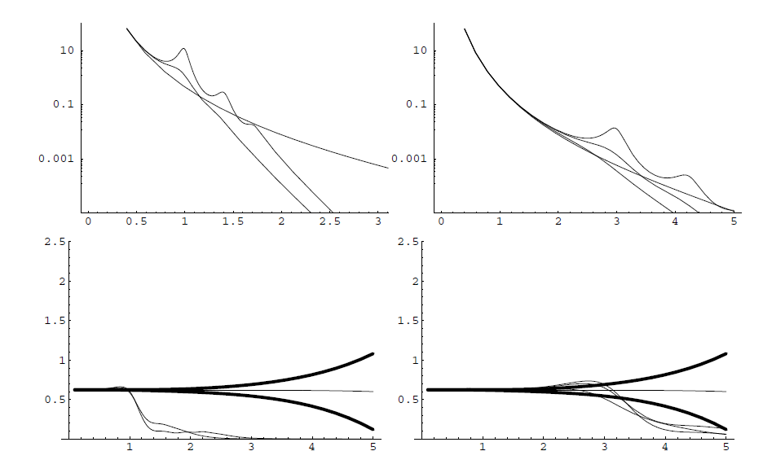
Quantum BH – two body final states (TBFS)
M_s=1 TeV
M_s=3 TeV
String xsecs and
an asymmetry
for different γ
P. Meade and L. Randall, JHEP 05, 003 (2008), arXiv:0708.3017
More about strategy of compositeness tests, an asymmetry for TBFS etc. in CMS:
CMS Collaboration, PRL 105, 211801 (2010); PRL 105, 262001 (2010);
PRL 106, 201804 (2010).
See also ATLAS Collaboration, New J. Phys. 13, 053044 (2011).

Slide 24
Quantum black holes, more ideas
BH is a cross-point, in a some sense, between a quantum and semiclassical
approaches
New (fundamental) quantization rules for the compact ED volume and BH area
in Planck units
QBH gives a number of sharp resonance states (trajectory) with a Planck spacing
G. Dvali, C. Gomez, S. Mukhanov, JHEP 11, 012 (2011), arXiv:1006.2466;
arXiv: 1106. 5894.
...or, maybe, so:
QBH in non-commutative geometry approach
Strictly suppressed bulk emission, emission into a brane dominates
Softer spectra
P. Nicolini and E. Winstanley, JHEP 11, 075 (2011), arXiv:1108.4419

Slide 25
Black Hole or String Ball?
QBH, KK-modes of G
…..
M_{BH} >> M_{D} : semiclassical well-known description for BH’s.
What happens when M_{BH} approach M_{D}?
BH becomes “stringy”, their properties become complex.

Slide 26
Matching:
S. Dimopoulos and R. Emparan,
Phys. Lett. B526, 393 (2002), hep-ph/0108060

Slide 27
Final state of the SM process vs typical BH decay spectra
BH decay
SM Process
Multi-jet and hard leptons events
High spherical
High energy and p_{T}
Experimental observables
which are sensitive to these
features

Slide 28
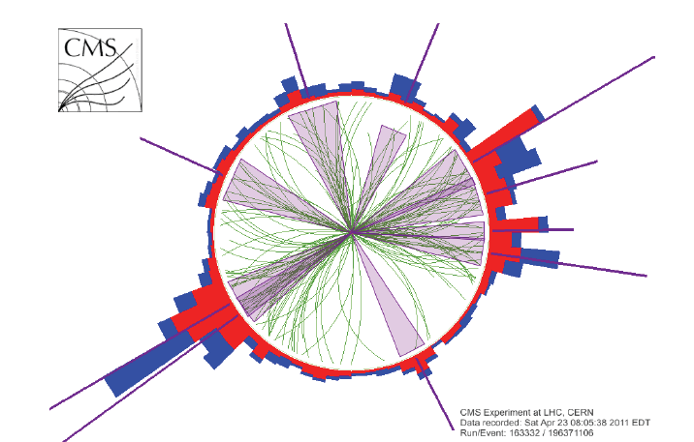
CMS real event visualisation, BH candidates
CMS Data, 2011
CMS 3D real event visualisation,
N = 9 BH candidate
S_{T} = 2.5 TeV (Run 165567,
Event 347495624)
CMS: the transverse view,
N = 10 BH candidate
S_{T} = 1.1 TeV (Run 163332,
Event 196371106)
CMS Data, 2011

Slide 29
S_{T} for events with N objects in the FS
The CMS analysis 2012-2013,
12.1 fb⁻¹:
JHEP 07 (2013) 178
arXiv:1303.5338 [hep-ex]

Slide 30
S_{T} for events with N objects in the FS
The CMS analysis 2012-2013,
12.1 fb⁻¹:
JHEP 07 (2013) 178
arXiv:1303.5338 [hep-ex]

Slide 31
JHEP 07 (2013) 178
arXiv:1303.5338 [hep-ex] (21 Mar 2013)

Slide 32
QBH Signatures
The CMS analysis
2012-2013, 12.1 fb⁻¹:
ADD
JHEP 07 (2013) 178
arXiv:1303.5338 [hep-ex]
M_{min} is excluded from
4.7 to 6.2 TeV
for
M_{D} up to 5 TeV
at
95 % CL.
Randall-Sundrum type

Slide 33
String Ball Exclusion Plot
The CMS analysis
2012-2013, 12.1 fb⁻¹:
JHEP 07 (2013) 178
arXiv:1303.5338 [hep-ex]
String ball limits from the counting experiments for a set of model parameters (string coupling g_{s}=0.4, fundamental scale M_{d} and string scale M_{s})
M_{min} is excluded from 5.5 to 5.7 TeV at 95 % CL.

Slide 34
Model independent cross section upper limits
JHEP 07 (2013) 178
arXiv:1303.5338 [hep-ex] (21 Mar 2013)

Slide 35
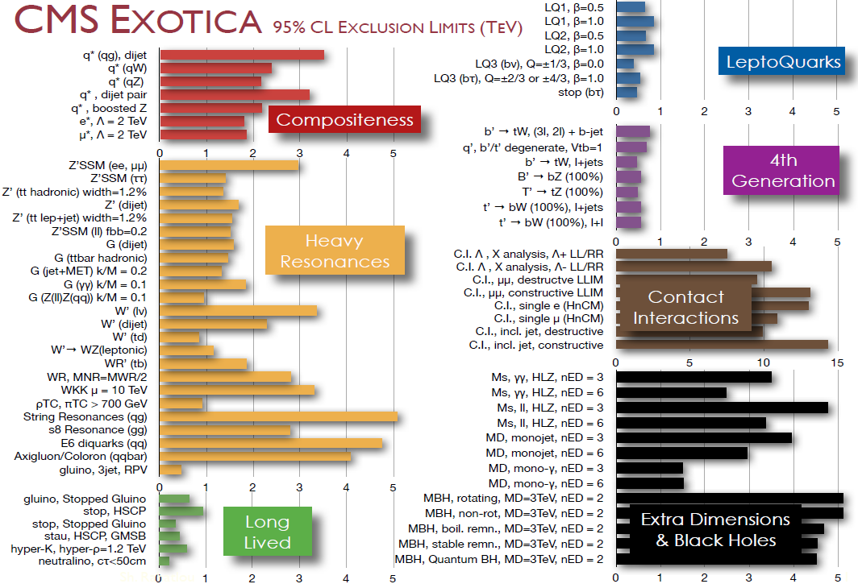
CMS Exotica Summary (95% C.L.)
35

Slide 36
Backup Slides

Slide 37
5D гравитация – одно дополнительное измерение
5D действие - только производные от полей
нулевая мода – безмассовое 4D поле, без потенциала
(в приближении малости флуктуаций)
массивные КК-поля
безмассовое калибровочное поле, защищенное остаточной
калибровочной симметрией:
оригинальная идея
Калуцы-Клейна по
объединению гравитации
и электромагнетизма
Эффективное 4D действие
остаточные симметрии :
4D калибровочная
4D общекоординатная

Slide 38
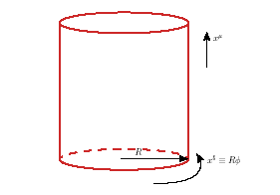
Результат КК-декомпозиции для 5D метрики
h_{AB} , А,В=1,…5 – многомерное поле.
После декомпозиции получаем набор полей в эффективном 4D действии:
4D тензоры
(массивные КК-моды)
стандартный
4D гравитон
4D вектор
(калибр. бозон)
гравискаляр
(модуль)
Скаляр вводится как поле без потенциала
и не зависит от доп. координат (по выбору
калибровки)
Ненулевое произвольное
ваккумное среднее

Slide 39
RS1 graviton vs Z’. Extended gauge sector
^{The Left-Right model (LR),}
^{SU(2)}_{L} ^{× SU(2)}_{R} ^{× U(1)}_{B−L},
^{g}_{L} ^{= g}_{R} = 0.64 (like the SM). # EFG = 3.
Z′_{χ}-, Z′_{η}-, and Z′_{ψ}-models,
GUT E₆ → SO(10) × U(1)_{ψ} →
SU(5) × U(1)_{χ} × U(1)_{ψ} → SM×U(1)_θ₆ .
Z′ = Z′_{χ} cos(θ_{E6} ) + Z′_{ψ} sin(θ_{E6} )
«Sequential» standard model (SSM)
Z′, W′ coupled only to left fermions with couplings and total widths as W, Z in SM.

Slide 40
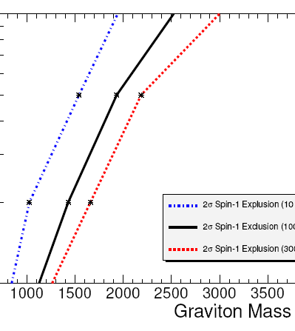
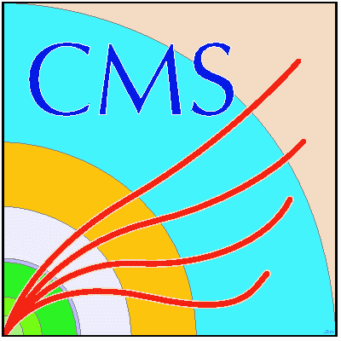
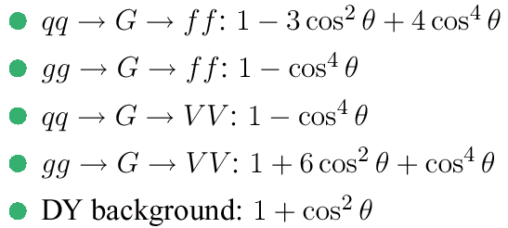
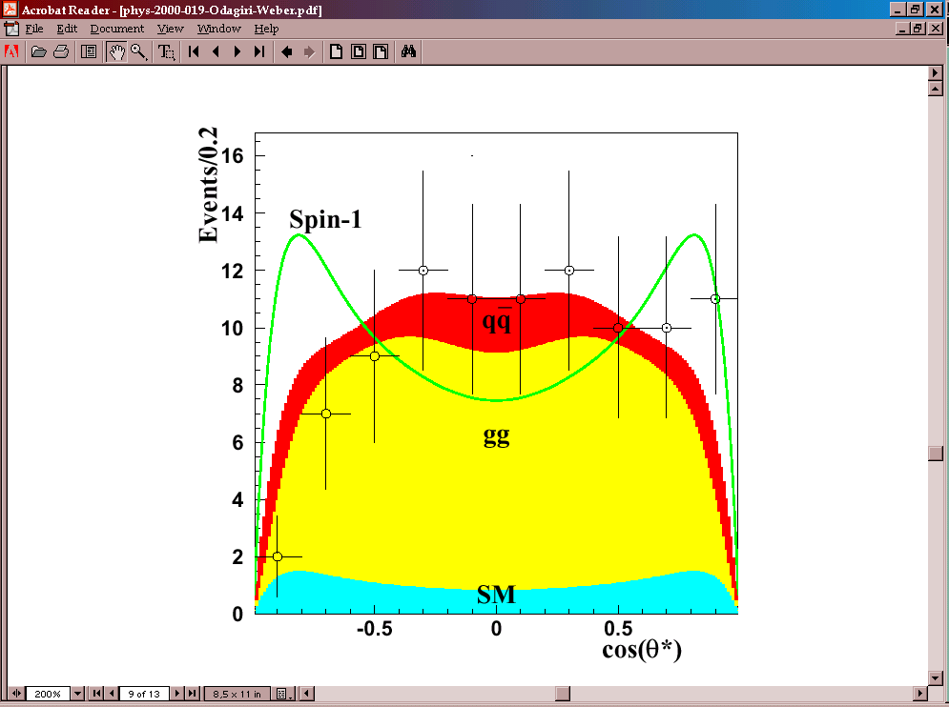
Spin-1/Spin-2 Discrimination
Spin-1 States: Z′ from extended gauge models, Z_{KK}
Spin-2 States: RS1-graviton
Method: unbinned likelihood ratio statistics incorporating the angles in of the decay products the Collins-Soper frame (R.Cousins et al. JHEP11 (2005) 046). The statististical technique has been applied to fully simu/reco events.
Angular distributions
Z’ vs RS1-graviton
I. Belotelov et al.
CMS NOTE 2006/104
CMS PTDR 2006
B.C. Allanach et al, JHEP 09 (2000) 019; ATL-PHYS-2000-029

